Slide 1
MARKETING ANALYTICS I
SESSION 9:
RECOMMENDATION SYSTEMS
Professor Sonnier
Texas MSBA Program
Fall 2022

Slide 2

A GENERAL TARGETING PROBLEM
A New Customer Shows Up*
Satisfaction Example
Is it a Segment 1/2 or 4 customer?
*NOTE: We can also think generally about an existing customer considering a new product/service

Slide 3
USING AN ATTITUDINAL SEGMENTATION TO TARGET
Call Center Example
How do you classify customers who do not take the survey?
For those that take the survey, you know the segment (i.e., class) of each respondent
You observe some customer characteristics (z) that are easily observed for all your customers
Can you develop a rule or algorithm that predicts class membership as a function of things you see for all customers?

Slide 4
USING AN ATTITUDINAL SEGMENTATION TO TARGET
You Need to Classify Inbound Customers
Can you link observed characteristics to probability of segment membership?
Event a is Seg 4
Event b is Seg 1 or 2
Now you have a rule to map observed covariates of new customers into segments
Can generalize to more than 2 segments

Slide 5
CONJOINT ANALYSIS
Data Pooled Over All Respondents
Individual Model
Each model has only T=12 observations!
How would you summarize and describe the beta coefficients above?

Slide 6
A RESPONSE MODEL WITH INDIVIDUAL LEVEL COEFFICIENTS
Mathematical Intuition
You observe some data you believe comes from a model
You have some beliefs about the parameters of your model
Suppose you observe some customer level characteristics
Age
Income
Education

Slide 7
A RESPONSE MODEL WITH INDIVIDUAL LEVEL COEFFICIENTS
Using Model for Targeting
You observe some data you believe comes from a model
You have some beliefs about the parameters of your model in relation to observed customer characteristics
Let prior for intercepts and betas from logit model be a function of z. For any the intercept or one of the betas (i.e., tuna, halibut, wild, farm and price) you have the following
With estimates of delta you can predict preferences conditional on observing characteristics for customer outside your sample

Slide 8
SEGMENTATION
Using Behavioral Data
Rule of thumb
Based on past behavior use simple statistics (no models) to predict future behavior
Heuristics
Create models that use behavior as a source of model building
The analyst decides what behavior to model
Model Driven
Notes:
This concept actually stems from John Hagel's and Marc Singer's HBR and McK Quarterly article "Unbundling the Corporation". Their hypothesis is that decreasing interaction costs will drive corporations (or at least those intent on staying competitive) to disaggregate according to the above overall "functions".
We introduce this concept to business unit strategy to help teams focus on those functions of the client and their competitors which are most crucial on the competitive battlefield. Thus most investigative effort will be spent where it really matters. In the pyramid introduced above we give some suggestions which frameworks/tools/concepts can be helpful for further analysis depending on the driver(s) of the business.
Of course many business units will have more than one value driver. A pharmaceutical BU, for example, might very well be competing as a customer relationship business (targeting its sales force for maximum impact with physicians) as well as competing as an innovation business (developing and managing its drug pipeline). Both drivers of the business will need to be examined by the team. In the spirit of Hagel and Singer this might also be the starting point to investigate possibilities to unbundle the functions of the BU or the corporation and have the client focus on the game he's prepared to play best at.

Slide 9


Slide 10
SEGMENTATION
Behavioral Bases for Segmentation
Revealed Preference Data
What customers actually do
Stated Preference Data
What customers say they will do

Slide 11
SEGMENTATION
Using Behavioral Data
Rule of thumb
Use simple statistics (no models) to predict behavior
Heuristics
Create models that use behavior as a source of model building
The analyst decides what behavior to model
Model Driven
Notes:
This concept actually stems from John Hagel's and Marc Singer's HBR and McK Quarterly article "Unbundling the Corporation". Their hypothesis is that decreasing interaction costs will drive corporations (or at least those intent on staying competitive) to disaggregate according to the above overall "functions".
We introduce this concept to business unit strategy to help teams focus on those functions of the client and their competitors which are most crucial on the competitive battlefield. Thus most investigative effort will be spent where it really matters. In the pyramid introduced above we give some suggestions which frameworks/tools/concepts can be helpful for further analysis depending on the driver(s) of the business.
Of course many business units will have more than one value driver. A pharmaceutical BU, for example, might very well be competing as a customer relationship business (targeting its sales force for maximum impact with physicians) as well as competing as an innovation business (developing and managing its drug pipeline). Both drivers of the business will need to be examined by the team. In the spirit of Hagel and Singer this might also be the starting point to investigate possibilities to unbundle the functions of the BU or the corporation and have the client focus on the game he's prepared to play best at.

Slide 12
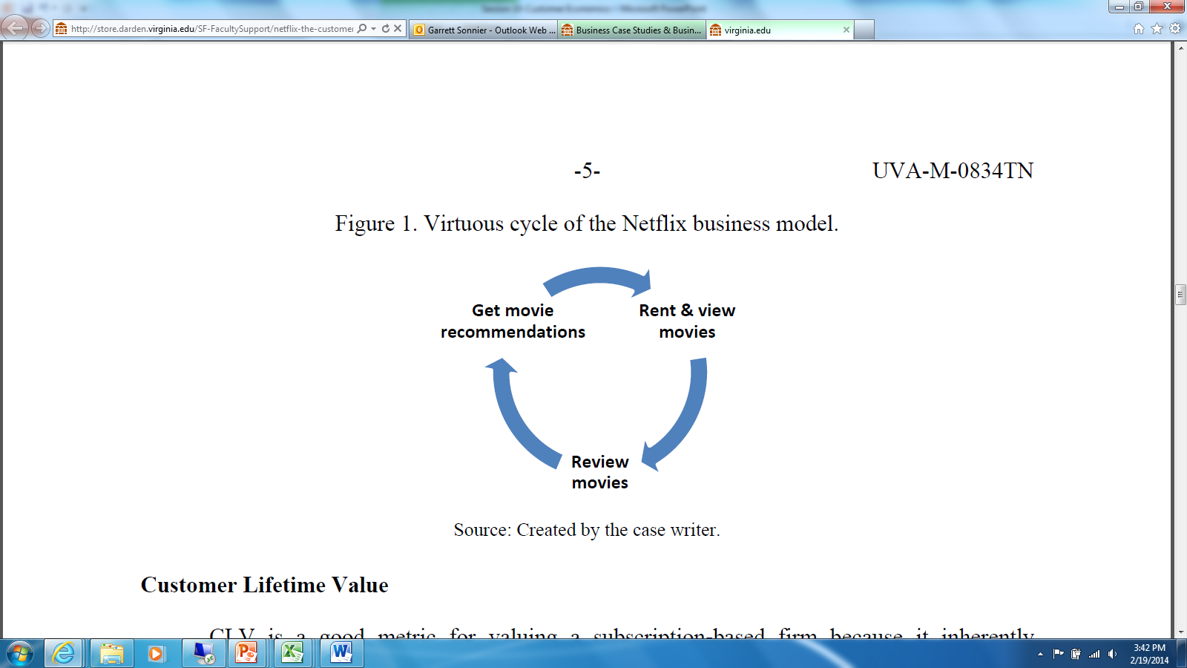
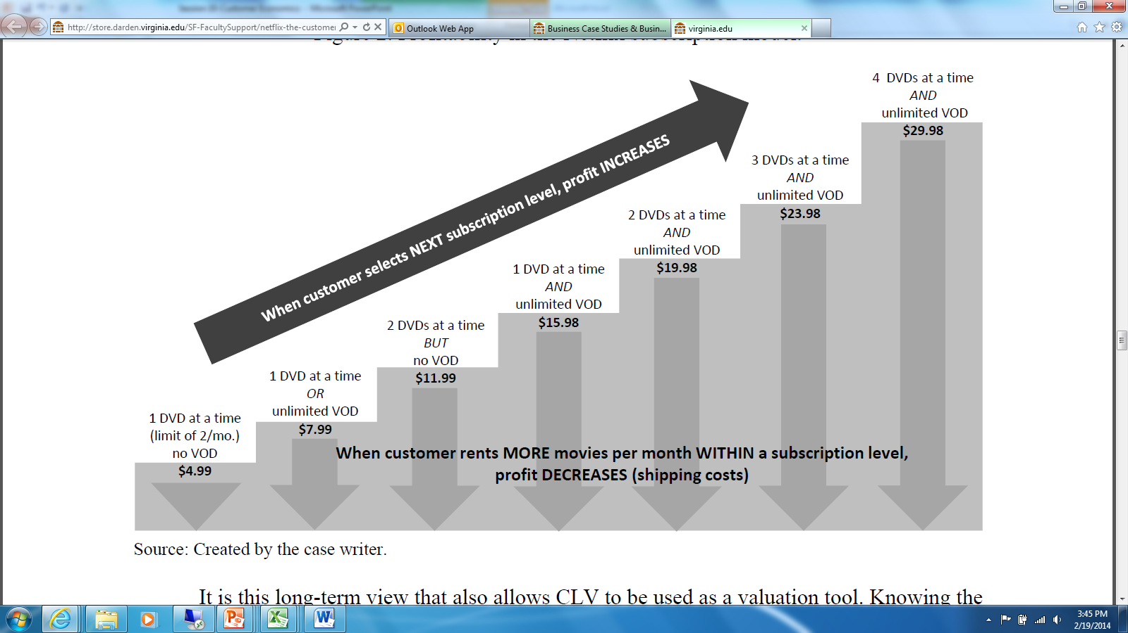
NETFLIX
The Original Business Model
Recs put more films in queue
Longer queue, more wait time
Select next tier of service
Increase usage and involvement
Increase retention

Slide 13
NETFLIX
Customer Acquisition in the Early Years

Slide 14
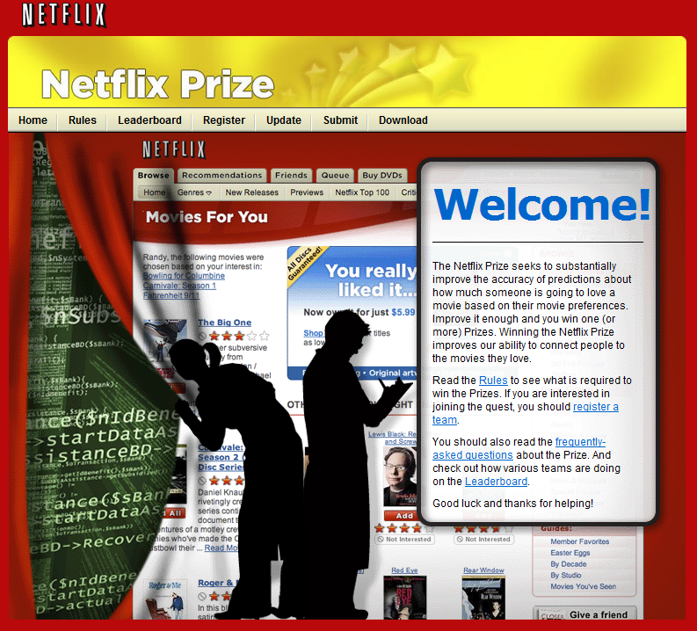
NETFLIX
Customer Development
13
Notes:
13
A scenario is a concise, well-integrated, holistic story that both describes a possible future state of the world and explains why that state may develop. It is internally consistent, plausible, and intellectually compelling. It helps managers think about potential threats and opportunities differently than they did in the past. A scenario is not a quantitative model or simulation of the future, nor is it a cast-in-stone prediction or belief of what the future will look like.
Level 2 scenarios result in discrete outcomes that can be formulated into decision trees. Due to the higher level of uncertainty in Level 3, scenario building entails developing representative outcomes.
Best practices for scenario development:
1) Limit the number of scenarios to three to five – any more tends to inhibit, rather than facilitate, decision-making
2) Ensure that scenarios are distinct in key features of industry structure, conduct, and performance. They are close to “mutually exclusive”
3) Ensure that scenarios, at the very least, cover the full range of plausible outcomes. They are close to “collectively exhaustive”
4) Explicitly define the baseline assumptions underlying all scenarios or “trends”
5) If possible, assign probabilities in Level 2, and probability distributions in Level 3

Slide 15
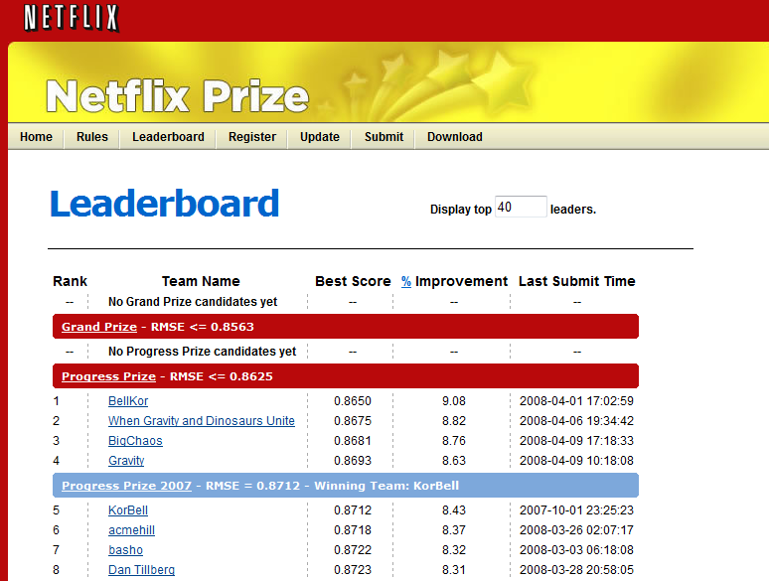
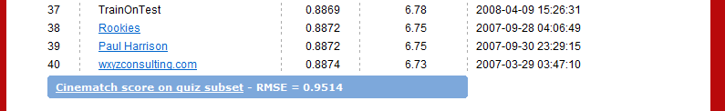
NETFLIX
Customer Development
14
Notes:
14
A scenario is a concise, well-integrated, holistic story that both describes a possible future state of the world and explains why that state may develop. It is internally consistent, plausible, and intellectually compelling. It helps managers think about potential threats and opportunities differently than they did in the past. A scenario is not a quantitative model or simulation of the future, nor is it a cast-in-stone prediction or belief of what the future will look like.
Level 2 scenarios result in discrete outcomes that can be formulated into decision trees. Due to the higher level of uncertainty in Level 3, scenario building entails developing representative outcomes.
Best practices for scenario development:
1) Limit the number of scenarios to three to five – any more tends to inhibit, rather than facilitate, decision-making
2) Ensure that scenarios are distinct in key features of industry structure, conduct, and performance. They are close to “mutually exclusive”
3) Ensure that scenarios, at the very least, cover the full range of plausible outcomes. They are close to “collectively exhaustive”
4) Explicitly define the baseline assumptions underlying all scenarios or “trends”
5) If possible, assign probabilities in Level 2, and probability distributions in Level 3

Slide 16
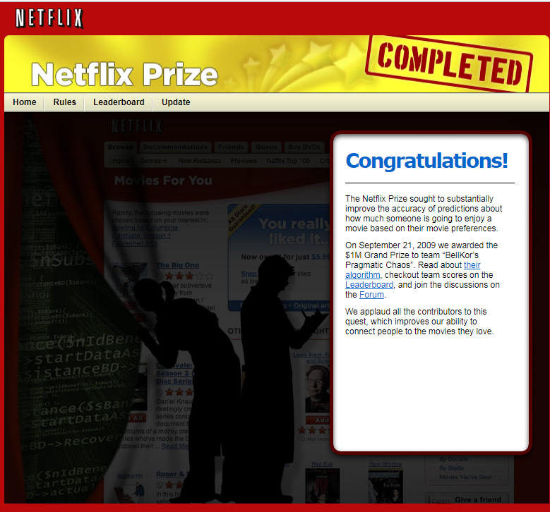
NETFLIX
Customer Development

Slide 17
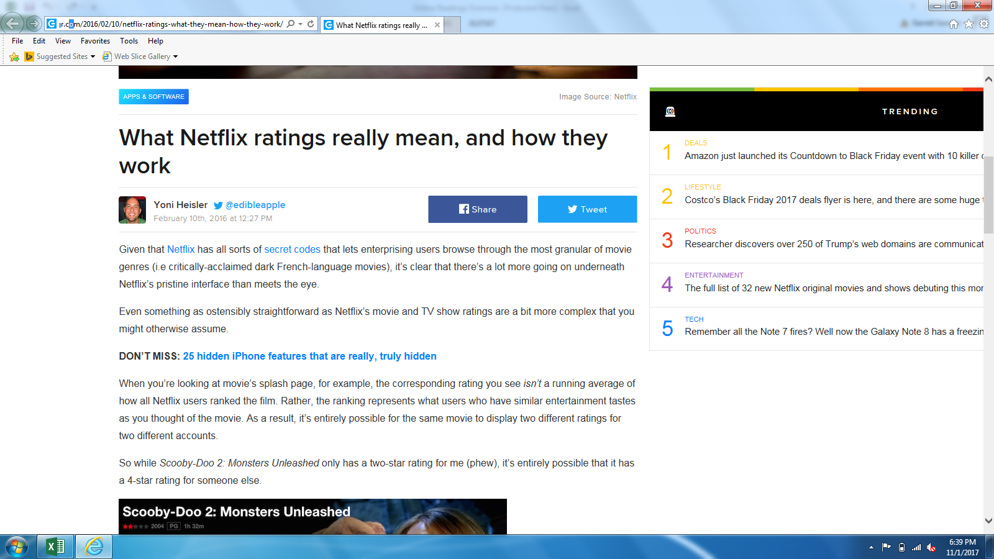
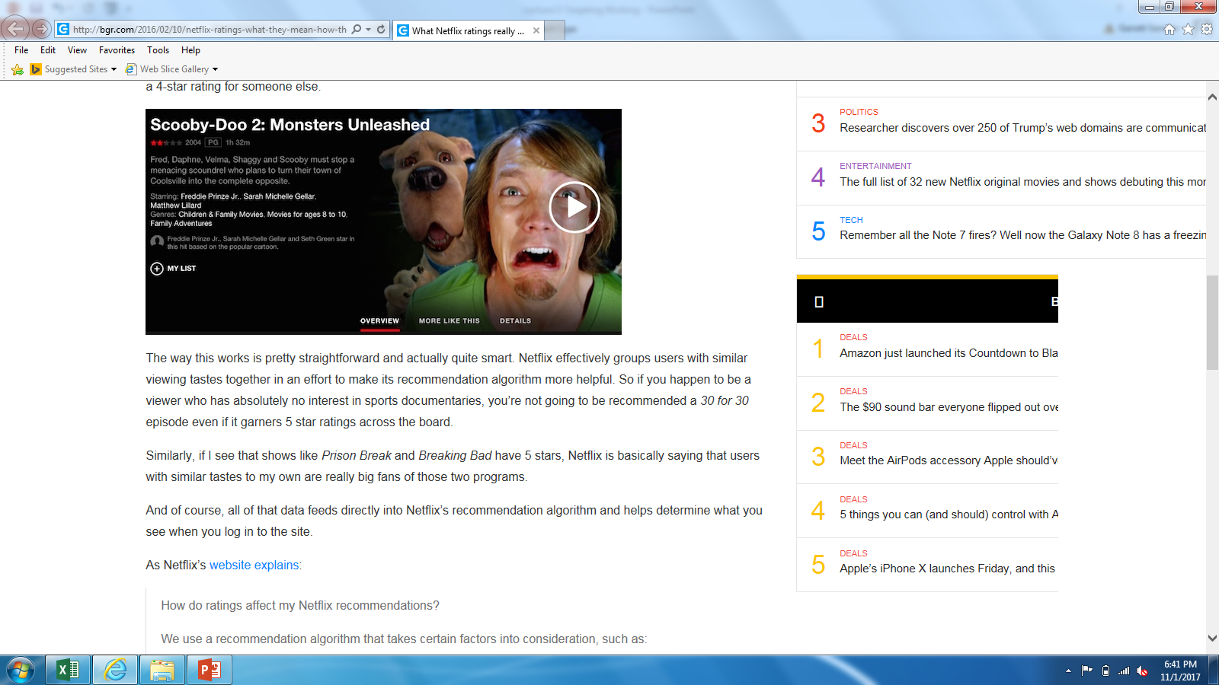
NETFLIX
Using Stated Preference Data for Segmentation and Targeting
http://bgr.com/2016/02/10/netflix-ratings-what-they-mean-how-they-work/

Slide 18
NETFLIX
Collaborative Filtering
A method of making predictions about the interests of a user by collecting preferences or taste information from many users
Commercialized by Net Perceptions and Firefly
17
Notes:
17
A scenario is a concise, well-integrated, holistic story that both describes a possible future state of the world and explains why that state may develop. It is internally consistent, plausible, and intellectually compelling. It helps managers think about potential threats and opportunities differently than they did in the past. A scenario is not a quantitative model or simulation of the future, nor is it a cast-in-stone prediction or belief of what the future will look like.
Level 2 scenarios result in discrete outcomes that can be formulated into decision trees. Due to the higher level of uncertainty in Level 3, scenario building entails developing representative outcomes.
Best practices for scenario development:
1) Limit the number of scenarios to three to five – any more tends to inhibit, rather than facilitate, decision-making
2) Ensure that scenarios are distinct in key features of industry structure, conduct, and performance. They are close to “mutually exclusive”
3) Ensure that scenarios, at the very least, cover the full range of plausible outcomes. They are close to “collectively exhaustive”
4) Explicitly define the baseline assumptions underlying all scenarios or “trends”
5) If possible, assign probabilities in Level 2, and probability distributions in Level 3

Slide 19
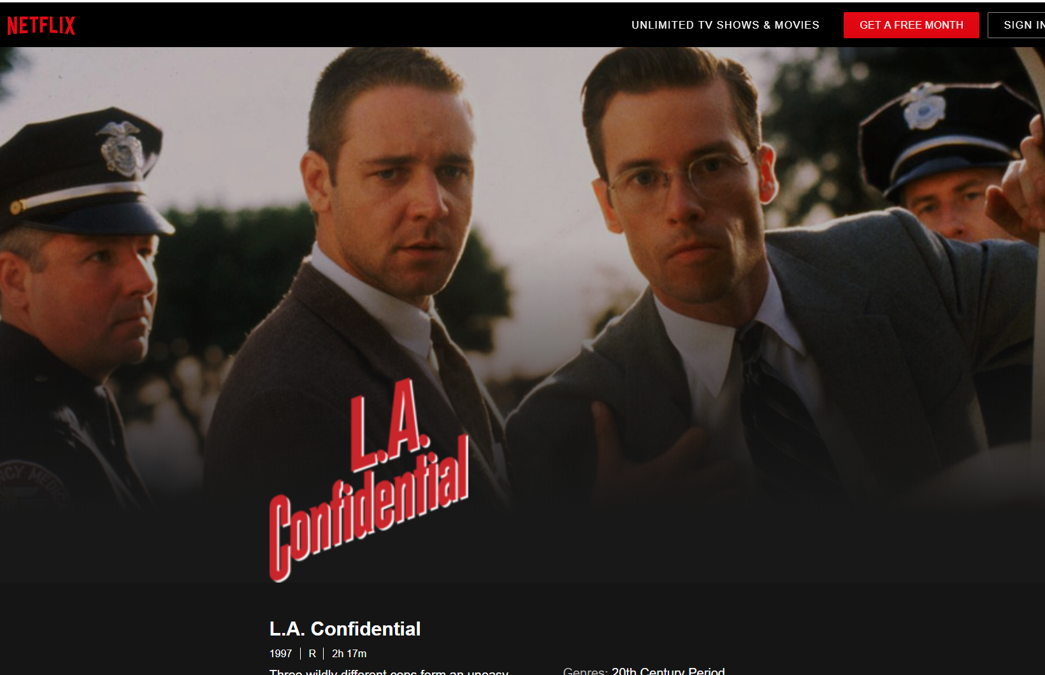

A GENERAL TARGETING PROBLEM
Should I Recommend LA Confidential to Garrett?
Garrett

Slide 20
NETFLIX
User Based Collaborative Filtering
Ratings for a set of customers
We want to know if Garrett will like L.A. Confidential*
*NOTE: The interested reader should know that Prof. Sonnier has actually seen L.A. Confidential. On a 5 point scale I rate it a 10. Clearly it should have won the Academy Award over that stupid Titanic movie. There was room on the door for Jack, too!!!

Slide 21
NETFLIX
Will Garrett Like L.A. Confidential?
Ratings for a set of customers
One guess would be the average rating for L.A. Confidential.
Another guess would be Garrett’s average rating
But Garrett’s preferences may be more or less similar to other users

Slide 22
NETFLIX
Will Garrett Like L.A. Confidential? A User Based Approach
Start with Garrett’s average rating
Now look at users who liked L.A. Confidential more or less than their average
Are these users positively or negatively similar to Garrett based on ratings?

Slide 23
NETFLIX
Will Garrett Like L.A. Confidential? A User Based Approach
Move estimate up from 4 if
User is positively similar to Garrett and likes L.A. Confidential more than their average movie
User is negatively similar to Garrett and likes L.A. Confidential less then their average movie
Move estimate down from 4 if
User is positively similar to Garrett and likes L.A. Confidential less than their average movie
User is negatively similar to Garrett and likes L.A. Confidential more then their average movie

Slide 24
NETFLIX
Correlation is a Measure of Similarity
Here we are computing correlations across users
Correlation Matrix of User Ratings
Jade is most negatively similar to Garrett
Raghu is most positively similar to Garrett

Slide 25
NETFLIX
Garrett’s Forecasted Rating for L.A. Confidential

Slide 26
NETFLIX
Garrett’s Forecasted Rating for L.A. Confidential

Slide 27
NETFLIX
Item Based Collaborative Filtering
Would our answer change if we used an item based filtering approach?

Slide 28
NETFLIX
Will Garrett Like L.A. Confidential? An Item Based Approach
Start with Garrett’s average rating
Now look at movies Garrett liked more or less than his average
Are these movies positively or negatively correlated with LA Confidential?

Slide 29
NETFLIX
Will Garrett Like L.A. Confidential?
Move estimate up from 4 if
Item is positively similar to L.A. Confidential and Garrett likes the item more than his average
Item is negatively similar to L.A. Confidential and Garrett the item less than his average
Move estimate down from 4 if
Item is positively similar to L.A. Confidential and Garrett likes the item less than his average
Item is negatively similar to L.A. Confidential and Garrett the item more than his average

Slide 30
NETFLIX
Correlation is a Measure of Similarity
Here we are computing correlations across items
Correlation Matrix of Item Ratings
There Will Be Blood is most similar to L.A. Confidential
The Hurt Locker is least similar to L.A. Confidential

Slide 31
NETFLIX
Garrett’s Forecasted Rating for L.A. Confidential

Slide 32
NETFLIX
Garrett’s Forecasted Rating for L.A. Confidential

Slide 33


NETFLIX
Garrett’s Forecasted Rating for L.A. Confidential
User Based Filter
Item Based Filter
They do not differ in computational complexity
They do not generally give the same rating
Intuitively when might you favor one or the other?
Could you combine them?

Slide 34
NETFLIX
Some More Thoughts on Collaborative Filters
Additional Issues to Consider
Popularity Bias: More popular items have more data and will be favored
Cold Start Problem: New items will have little to no data
Sparsity: User-Item matrix may contain many missing values

Slide 35
MATRIX FACTORIZATION
How Else to Predict Missing Ratings?
There are i=1,…,N users
There are j=1,…, M items
The rating R_{ij} is the rating user i gives to item j
In practice N and M may be very large
We observe some ratings and some are missing

Slide 36
MATRIX FACTORIZATION
How Else to Predict Missing Ratings?
This matrix is N users long by M movies wide
It is a coincidence that N and M are both equal to six in this example
Imagine now that there is a latent attribute that describes users

Slide 37
MATRIX FACTORIZATION
How Else to Predict Missing Ratings?
Imagine now that there is a latent attribute x that describes users
x is an N by 1 column
N is the number of users
And a second latent attribute y that describes items
y is an 1 by M row
M is the number of items

Slide 38
MATRIX FACTORIZATION
How Else to Predict Missing Ratings?
What do I get if I multiply these two latent attributes?
y is an 1 by M row
x is an N by 1 column

Slide 39
MATRIX FACTORIZATION
How Else to Predict Missing Ratings?
What do I get if I multiply these two latent attributes?
X is an N by 1 column
y is an 1 by M row
xy is an N by M matrix, just like the ratings matrix
If I can find x and y, I can impute all ratings
What about more than one latent attribute per user and item?
How do I find x and y (or multiple x and y)?

Slide 40
MATRIX FACTORIZATION
How Else to Predict Missing Ratings?
What about more than one latent attribute per user and item?
Y is an 2 by M rows
X is an N by 2 columns
XY is an N rows by M cols
Each entry SP(i,j) is the SUMPRODUCT of row i from X and col j from Y
I can have more than 1 latent attribute
How to find X and Y?

Slide 41
MATRIX FACTORIZATION
How Else to Predict Missing Ratings?
How to find X and Y
Fix K to be some small number
Find X and Y such that the sum of squared errors between observed and predicted rating is minimized
Alternative Least Squares
Fix X and solve problem for Y
Fix Y and solve problem for X
Repeat until convergence
Need to find K
Can add regularization penalties to avoid overfitting

Slide 42


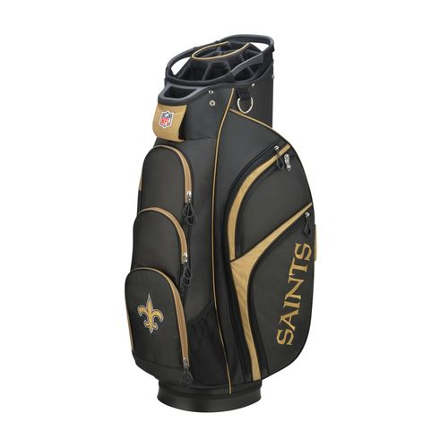
A GENERAL TARGETING PROBLEM
What Should a Retailer Show Me?
Garrett

Slide 43
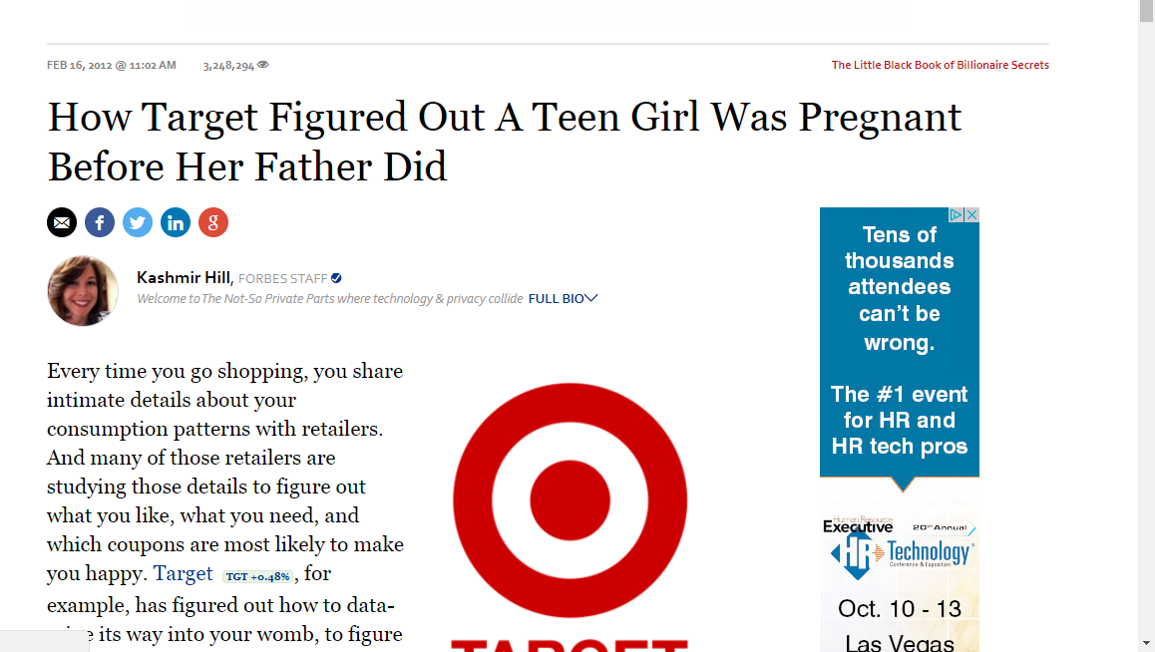
TARGETING
Market Basket Analysis

Slide 44
TARGETING
Market Basket Analysis
Goal of Market Basket Analysis (MBA) is to detect patterns in what products get bought together or in close proximity
• Credit card purchases (e.g., airline tickets, hotel rooms) help predict subsequent purchases
• Recognizing services often purchased simultaneously may suggest bundling, as in telecom industry
• Banking services used by customers may suggest up-selling or cross-selling
• Unusual combinations of insurance claims may alert firm to fraud
43
Notes:
43
A scenario is a concise, well-integrated, holistic story that both describes a possible future state of the world and explains why that state may develop. It is internally consistent, plausible, and intellectually compelling. It helps managers think about potential threats and opportunities differently than they did in the past. A scenario is not a quantitative model or simulation of the future, nor is it a cast-in-stone prediction or belief of what the future will look like.
Level 2 scenarios result in discrete outcomes that can be formulated into decision trees. Due to the higher level of uncertainty in Level 3, scenario building entails developing representative outcomes.
Best practices for scenario development:
1) Limit the number of scenarios to three to five – any more tends to inhibit, rather than facilitate, decision-making
2) Ensure that scenarios are distinct in key features of industry structure, conduct, and performance. They are close to “mutually exclusive”
3) Ensure that scenarios, at the very least, cover the full range of plausible outcomes. They are close to “collectively exhaustive”
4) Explicitly define the baseline assumptions underlying all scenarios or “trends”
5) If possible, assign probabilities in Level 2, and probability distributions in Level 3

Slide 45
TARGETING
Market Basket Analysis
1. Describe items
2. List the items bought in each basket
3. Construct the N×P basket matrix, where N is the number of baskets and P is the number of products
4. For each pair of products, compute
(a) Scope (sometimes called Support)
(b) Confidence
(c) Lift
Market Basket Analysis
44
Notes:
44
So the research question here is
whether (and how) demand uncertainty impacts consumer choice between three-part tariffs (DEMAND = USAGE)
And what the effect of this demand uncertainty is on consumer surplus and provider revenue UNDER THREE-PART TARIFFS
Even though there is a lot of plans like this it is turns out, that this is not well studied
You might ask – well, why is this relevant, why care about it
First, understanding consumer behavior helps firms to set prices (potentially also segment along usage uncertainty, not only usage level)
Regulators to monitor firms’ pricing behavior
Researchers to understand why three-part tariffs are so common
I will now set out to
First, give an intuitive explanation
Then, introduce my data and a model
Last, show empirical results that show the role of uncertainty

Slide 46
TARGETING
Market Basket Analysis
Is there an “if-then” relation between buying lotion and vitamins
45
Notes:
45
So the research question here is
whether (and how) demand uncertainty impacts consumer choice between three-part tariffs (DEMAND = USAGE)
And what the effect of this demand uncertainty is on consumer surplus and provider revenue UNDER THREE-PART TARIFFS
Even though there is a lot of plans like this it is turns out, that this is not well studied
You might ask – well, why is this relevant, why care about it
First, understanding consumer behavior helps firms to set prices (potentially also segment along usage uncertainty, not only usage level)
Regulators to monitor firms’ pricing behavior
Researchers to understand why three-part tariffs are so common
I will now set out to
First, give an intuitive explanation
Then, introduce my data and a model
Last, show empirical results that show the role of uncertainty

Slide 47
TARGETING
Market Basket Analysis
Basket Matrix of Purchases
46
Notes:
46
So the research question here is
whether (and how) demand uncertainty impacts consumer choice between three-part tariffs (DEMAND = USAGE)
And what the effect of this demand uncertainty is on consumer surplus and provider revenue UNDER THREE-PART TARIFFS
Even though there is a lot of plans like this it is turns out, that this is not well studied
You might ask – well, why is this relevant, why care about it
First, understanding consumer behavior helps firms to set prices (potentially also segment along usage uncertainty, not only usage level)
Regulators to monitor firms’ pricing behavior
Researchers to understand why three-part tariffs are so common
I will now set out to
First, give an intuitive explanation
Then, introduce my data and a model
Last, show empirical results that show the role of uncertainty

Slide 48
TARGETING
Market Basket Analysis
Consider any pair of products, A and B
We want to investigate “if A, then B”
Scope (A)
Scope (B)
Confidence (B|A)
Confidence (B|A)
Lift
=
Scope (B)

Slide 49
TARGETING
Market Basket Analysis
Evaluate “If lotion, then vitamins”
Scope (Lotion)
Scope (Vitamins)
Confidence (Vitamins|Lotion)
48
Notes:
48
So the research question here is
whether (and how) demand uncertainty impacts consumer choice between three-part tariffs (DEMAND = USAGE)
And what the effect of this demand uncertainty is on consumer surplus and provider revenue UNDER THREE-PART TARIFFS
Even though there is a lot of plans like this it is turns out, that this is not well studied
You might ask – well, why is this relevant, why care about it
First, understanding consumer behavior helps firms to set prices (potentially also segment along usage uncertainty, not only usage level)
Regulators to monitor firms’ pricing behavior
Researchers to understand why three-part tariffs are so common
I will now set out to
First, give an intuitive explanation
Then, introduce my data and a model
Last, show empirical results that show the role of uncertainty

Slide 50
TARGETING
Market Basket Analysis
Evaluate “If lotion, then vitamins”
Scope (Lotion)
Scope (Vitamins)
Confidence (Vitamins|Lotion)
Confidence (Vitamins|Lotion)
Lift
Scope (Vitamins)
Scope: Lotion occurs in about half the baskets (44%)
Confidence: In three quarters (75%) of the baskets with lotion we also see vitamins
Lift: If I observe a lotion purchase the probability of a vitamin purchase is 12% higher compared with the baseline probability of 67%
49
Notes:
49
So the research question here is
whether (and how) demand uncertainty impacts consumer choice between three-part tariffs (DEMAND = USAGE)
And what the effect of this demand uncertainty is on consumer surplus and provider revenue UNDER THREE-PART TARIFFS
Even though there is a lot of plans like this it is turns out, that this is not well studied
You might ask – well, why is this relevant, why care about it
First, understanding consumer behavior helps firms to set prices (potentially also segment along usage uncertainty, not only usage level)
Regulators to monitor firms’ pricing behavior
Researchers to understand why three-part tariffs are so common
I will now set out to
First, give an intuitive explanation
Then, introduce my data and a model
Last, show empirical results that show the role of uncertainty

Slide 51
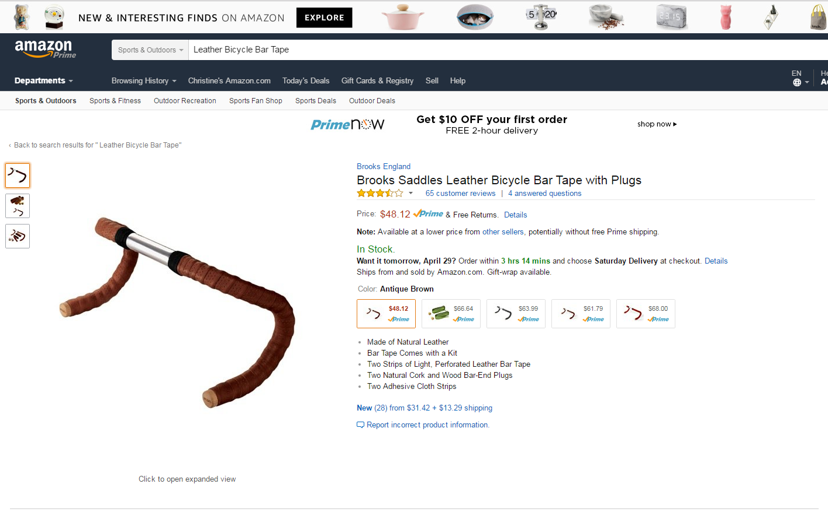
TARGETING
Amazon’s Recommendation System
50
Notes:
50

Slide 52
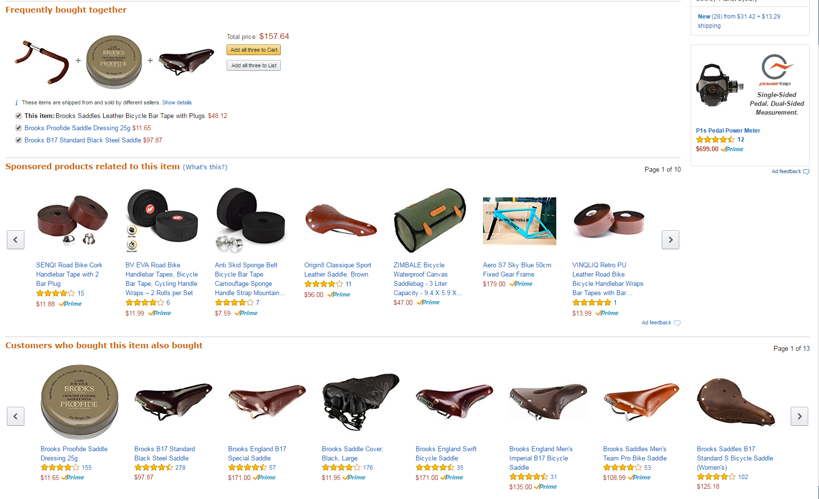
TARGETING
Amazon’s Recommendation System
51
Notes:
51

Slide 53
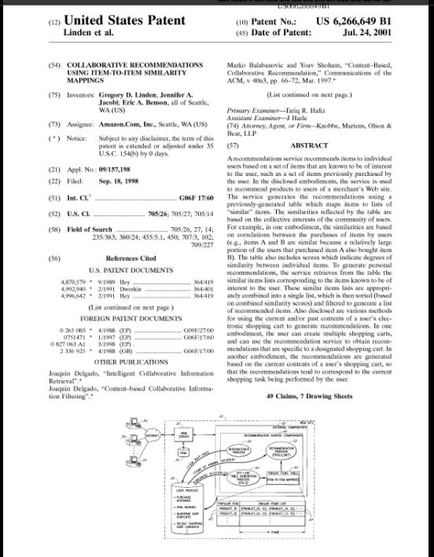
TARGETING
Amazon’s Recommendation System

Slide 54
TARGETING
Amazon’s Recommendation System
Amazon’s Approach: Patent 6,266,649
Reduce a multivariate problem to a sequence of bivariate problems:
• Similarity S_{AB} between two products A,B is
For any two products A and B, how many times do people buy A and B together (n_{AB}) vs. total A (n_{A}) and total B (n_{B})
Very close to lift analysis done by brick and mortar retailers
Sort items in “short list” by the highest S_{AB} lift an item has with any of the items in the history
Number of times A and B are bought together
53
Notes:
53

Slide 55
EXAMPLE – AMAZON’S RECOMMENDATION LIST

Slide 56
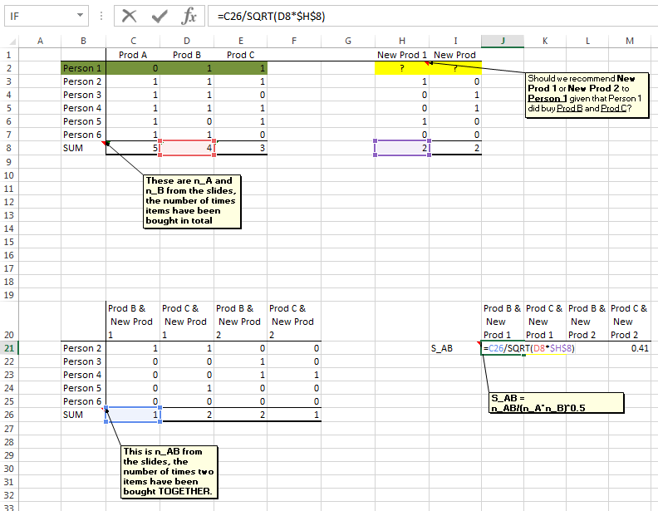
EXAMPLE – AMAZON’S RECOMMENDATION LIST

Slide 57
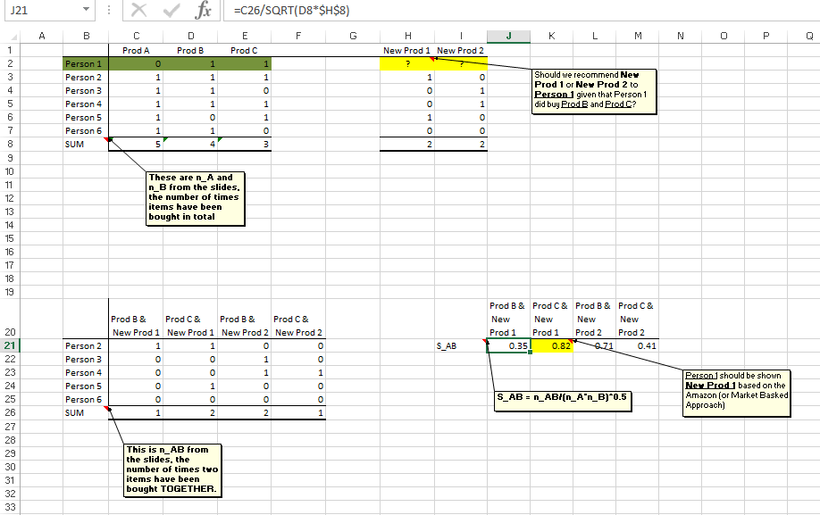
EXAMPLE – AMAZON’S RECOMMENDATION LIST

Slide 58
TARGETING BASED ON HEURISTIC RULES
Key Concepts from Today
Heuristic rules are
Simple (relatively!)
Fast
Scalable (usually!)
Require manager to make decisions on action to take
Examples Include:
User and Item Based Collaborative Filters
Matrix Factorization
Market Basket Analysis

Slide 59
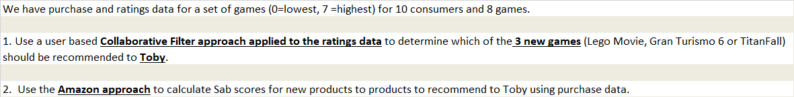
TARGETING
Example Problems on Recommendation Systems
Ratings Data
Purchase Incidence Data

